Slide 1
Airline operations
Aryan Wagh
Chanukya Bolli
Sowmya Ram Erni

Slide 2
AGENDA
Introduction of Topic & Data
Purpose Of Study
Business Benefits
Descriptive Analytics
​Recommendations
Summary

Slide 3
Introduction of topic & data
We have selected the topic of "Airline On-Time Performance and Flight Delay Causes" for our research, using the dataset provided by the Bureau of Transportation Statistics (BTS). This dataset includes information regarding airline punctuality and the underlying reasons for flight delays, spanning from January 2004 to December 2019.
It includes a comprehensive set of details, including the year, month, specific airline, airport, flight counts, delayed flight counts, and the factors attributing to these delays. These delay factors are classified into five main categories: Air Carrier, Extreme Weather, National Aviation System (NAS), Late-Arriving Aircraft, and Security.
This dataset is a valuable resource for analyzing trends and patterns in flight delays, helping airlines, airports, policymakers, and travelers understand and address the factors contributing to delays in the U.S. aviation system.

Slide 4
Purpose of study
The purpose of our study on airline on-time performance and flight delays is multifaceted.
By analyzing delay causes such as maintenance issues, weather conditions, and late-arriving aircraft, airlines can identify patterns and implement targeted strategies to minimize disruptions, improving overall operational efficiency and passenger satisfaction.

Slide 5
Business benefits
• Improved flight planning: Airlines can use our study to identify potential delays and reroute flights accordingly. This can help to reduce the number of flight cancellations and delays, which can lead to better customer satisfaction.
• Reduced fuel costs: By identifying and avoiding weather delays, airlines can save on fuel costs. This is because planes use more fuel when they are taxiing and taking off, so delays can significantly increase fuel consumption.
• Increased revenue: By improving on-time performance, airlines can attract more customers. This is because passengers are more likely to choose an airline that has a good track record of getting them to their destination on time.
• Improved customer service: Airlines can use the predictions we made from our study to identify the root causes of delays and take steps to prevent them in the future. This can lead to better customer service and a more positive experience for passengers.

Slide 6
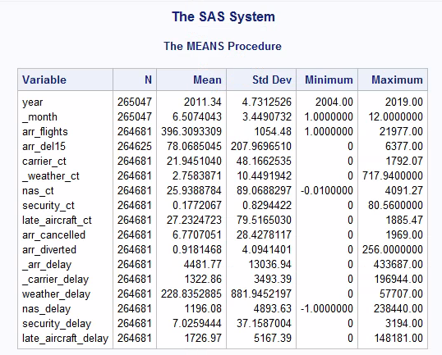
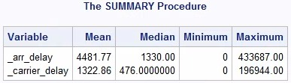
Proc means
PROC SUMMARY

Slide 7

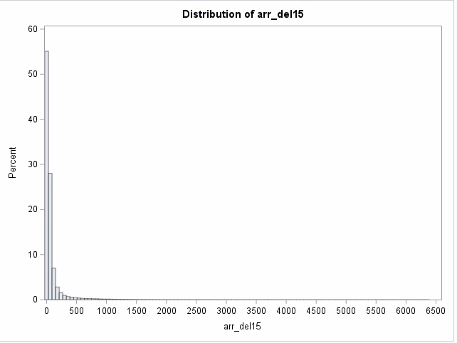
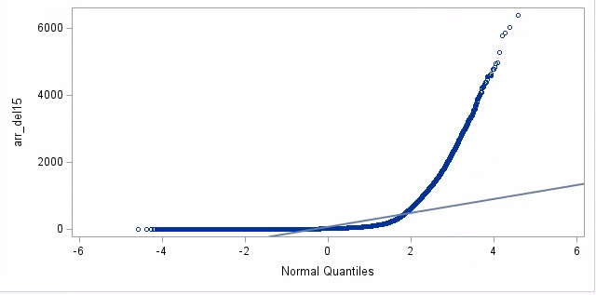
Proc univariate

Slide 8
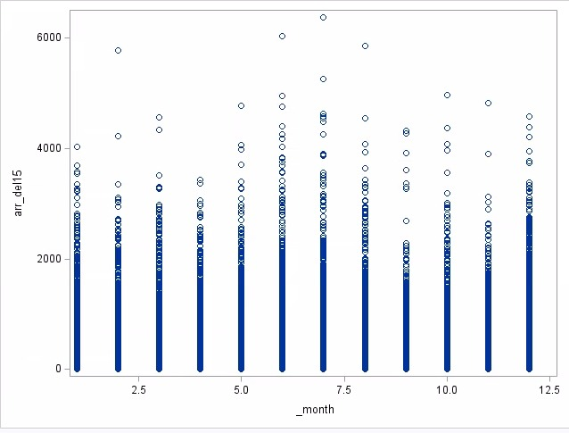
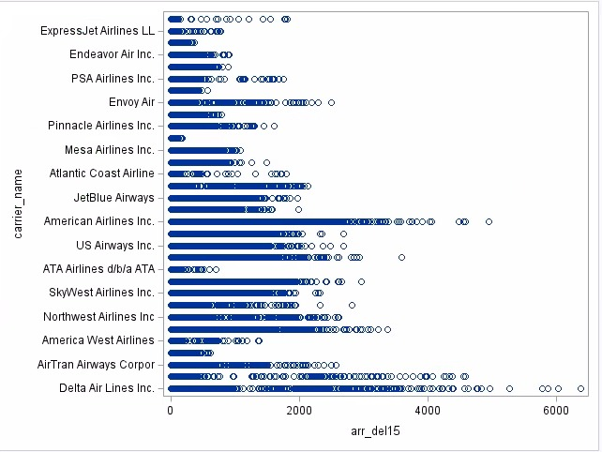
Graphs

Slide 9
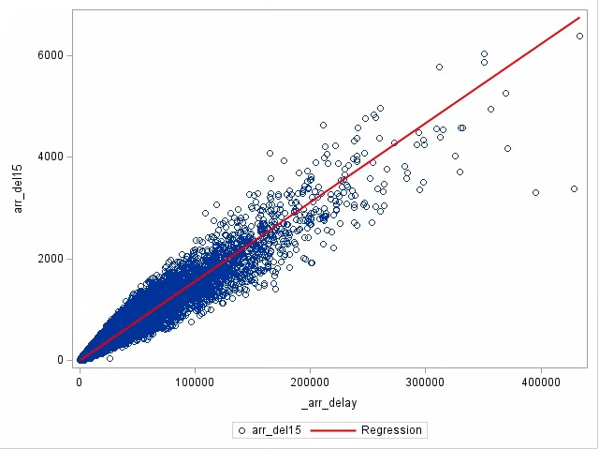
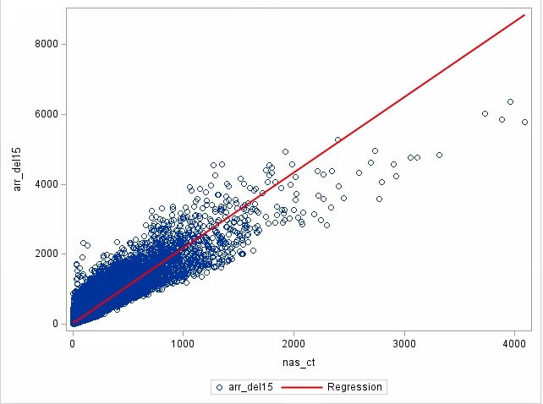
Graphs

Slide 10
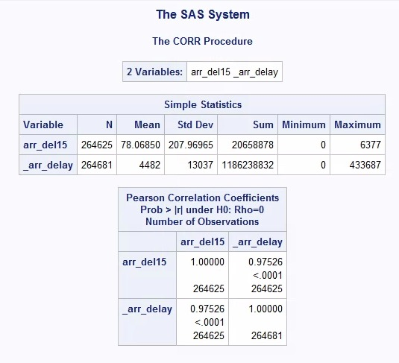
Correlation Analysis

Slide 11
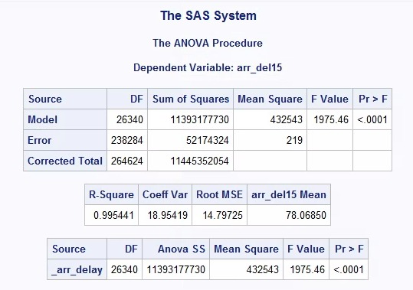
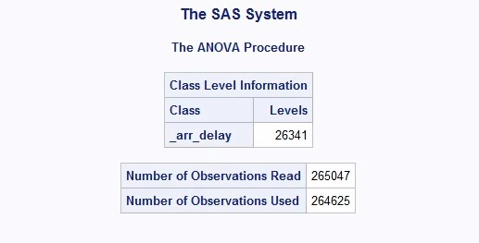
Anova Analysis

Slide 12
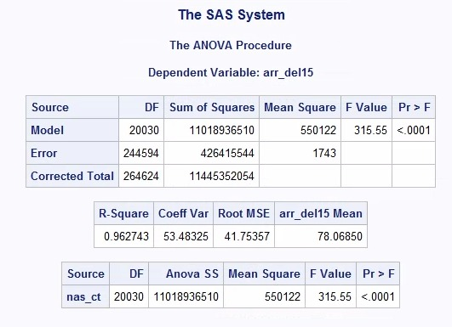
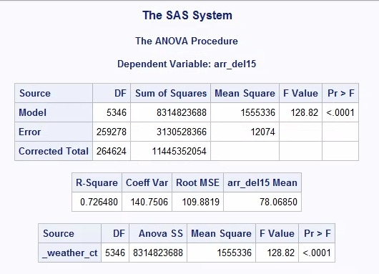
Anova Analysis

Slide 13
Recommendations
The strong correlation observed between arr_del15 & _arr_delay as revealed by the ANOVA analysis, suggests that an increase in the cumulative arrival delay time directly corresponds to a higher probability of flight delays.
Therefore, by understanding this relationship, airlines can anticipate potential delays, take proactive measures to manage flight schedules, and allocate resources more efficiently, leading to a more streamlined operation and an enhanced on-time performance.

Slide 14
SUMMARY
This analysis also aids in optimizing resource allocation, enabling airlines to efficiently manage crew scheduling, maintenance procedures, and airport operations, leading to cost savings.
Moreover, understanding security-related delays enhances airport safety measures and compliance with regulations, ensuring passenger and crew well-being.

Slide 15
THANK YOU

